Slide 1
Python
PIII: Scope + Exception
Handling

Slide 2
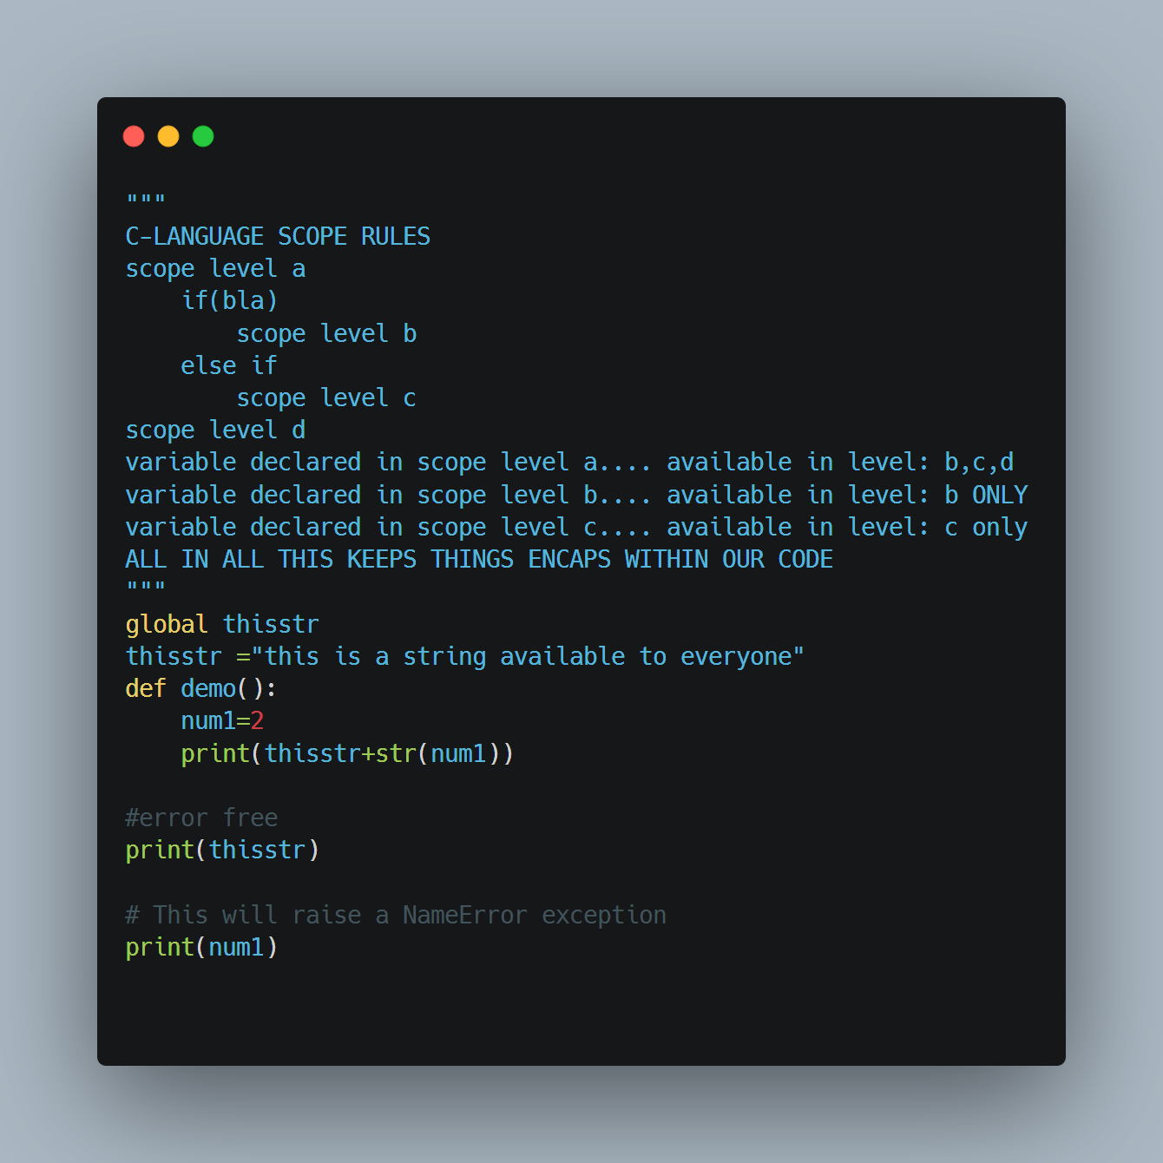
What is Scope?
Who has access to what
Gives me the ability to restrict who can access what in my program
A set of rules which outline how a var is searched
There are three types of scope
Global[main]
Local[main]
built-in

Slide 3
Why do we need scope
Discord Group
Administrator
Can do anything to you as an ordinary user
See/modify the rules for group participation
Can invite/kick a user
Moderator
See most of outside view and have the ability modify the outside view
Unable to modify or view the inner workings of the server
User
Participant
Has some features but not a lot of power

Slide 4
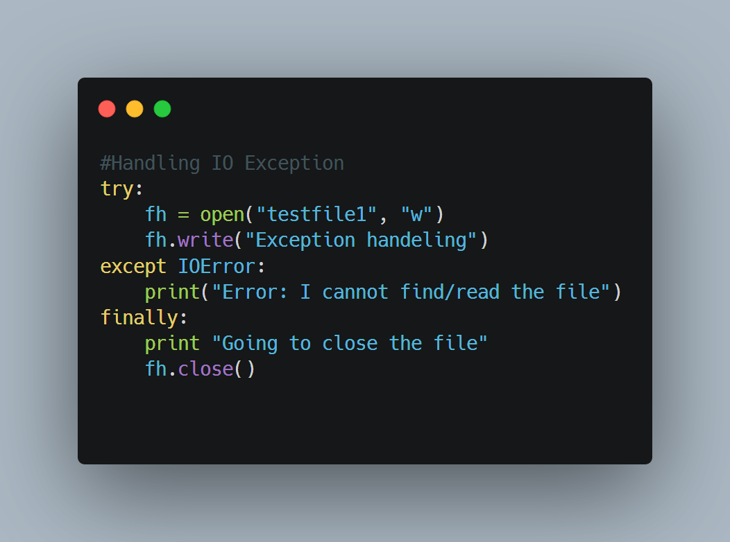
<! Exception Handling />
Returns an error or exceptions sometimes when there is no programmatic or syntax mistake in our program
Raise an exception when you enter a wrong input
Use a try-catch block and be descriptive for your exception so that the user can understand what he did wrong

Slide 5
Cont..

Slide 6
Good Practices
Avoid nested try-except blocks because it reduces the readability of the code
Always try to handle the exception in the code to avoid abnormal termination of the program
When creating a custom exception class, suffix its name with “Error”.
If the except clauses have the same code, try to catch multiple exceptions in a single except block.Use finally block to close heavy resources and remove heavy objects.
Use else block to log successful execution of the code, send notifications, etc.

Slide 7
Good Practices
Avoid bare except clause as much as possible. If you don’t know about the exceptions, then only use it.
You can catch exceptions in an except block and then raise another exception that is more meaningful.
Always raise exceptions with meaningful messages to be respectful to the user.

Slide 8
Recap

Slide 9
A variable inside a f(x) having the keyword global is available to _______
Everyone
Local members of the function
Nobody

Slide 10
A variable inside a f(x) having the keyword global is available to _______
Everyone
Local members of the function
Nobody

Slide 11
A variable declared within a function is available ...
Everywhere
Local to the function and inaccessible from outside
Available to everyone except to members of the function

Slide 12
A variable declared within a function is available ...
Everywhere
Local to the function and inaccessible from outside
Available to everyone except to members of the function

Slide 13
Which keyword is used to handle an exception
Except
Raise
Try
Block

Slide 14
Which keyword is used to handle an exception
Except
Raise
Try
Block

Slide 15
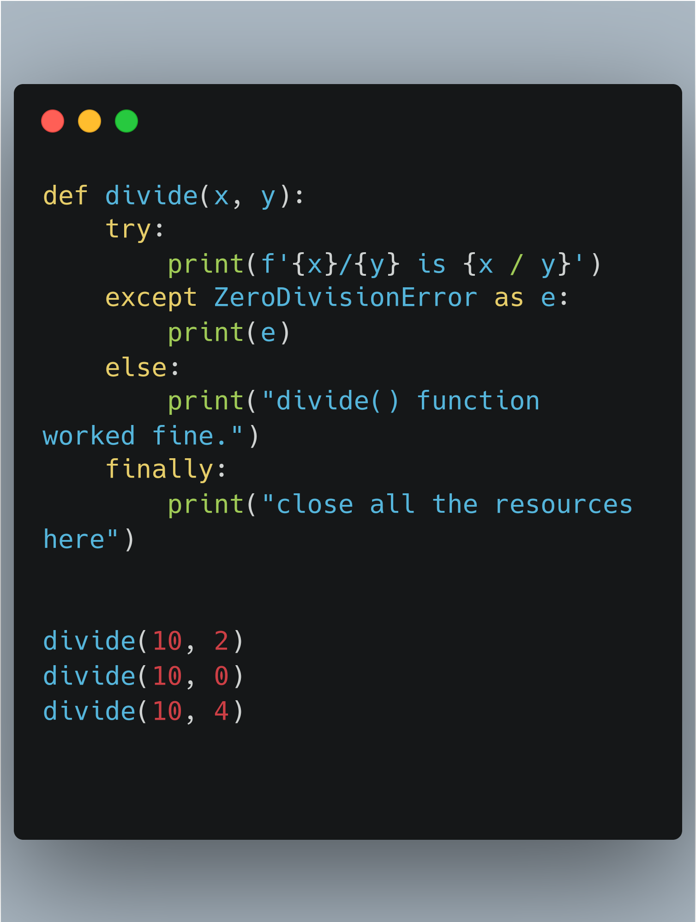

Slide 16
Which keyword is used to raise an exception
Raise
Local members of the function
Nobody

Slide 17
Which keyword is used to raise an exception
Raise
Local members of the function
Nobody

Slide 18
What happens in the execution phase if I have no errors within my try block
Nothing happens
My program crashes
My computer sleeps
The next block of code is executed that follows the except block

Slide 19
What happens in the execution phase if I have no errors within my try block
Nothing happens
My program crashes
My computer sleeps
The next block of code is executed that follows the except block

Slide 20
Python allows me to divide by zero
True
False

Slide 21
Python allows me to divide by zero
True
False

Slide 22
Which error is raised if I divide by zero?
CIsTheWorstError
Import Error
ModuleNotFoundError
ZeroDivisionError

Slide 23
Which error is raised if I divide by zero?
CIsTheWorstError
ImportError
ModuleNotFoundError
ZeroDivisionError

Slide 24
I did not specify the right file path or name correctly my file raises which error
NullPointerError
FileFoundError
FileNotFoundError
FileExistsError

Slide 25
I did not specify the right file path or name correctly my file raises which error
NullPointerError
FileFoundError
FileNotFoundError
FileExistsError

Slide 26
A Warning And An Error
Your program will terminate if it encounters an error. If there is a warning it just prints it to the console.
Same thing Essen. Synonymous
Your program will run fine with an error
Execution will stop when your programs encounters a warning

Slide 27
A Warning And An Error
Your program will terminate if it encounters an error. If there is a warning it just prints it to the console
Same thing Essen. Synonymous
Your program will run fine with an error
Execution will stop when your programs encounters a warning

Slide 28
??Questions??
Ask every person if they
understood

Slide 29
Thank you

